Slide 1

ANALYSIS OF FACTORS AFFECTING CONCRETE COMPRESSIVE STRENGTH
Dhanalakshmi Gowda

Slide 2
Quality Inconsistencies in Concrete Production
Background:
Essential for construction projects globally, concrete holds a pivotal role. Presently, the construction aggregates firm confronts issues with inconsistent concrete quality, resulting in client complaints, sales target setbacks, and reputational harm.
Problem Statement:
The main concern pertains to fluctuations in concrete compressive strength, a vital trait directly impacting structural quality and longevity. Despite upgrading the production plant and thorough pre-production raw material testing, concerns about inconsistent quality have risen. Budget limitations have postponed the acquisition of dedicated equipment to measure concrete strength.
Objective:
This analysis aims to identify the elements impacting concrete compressive strength and create a predictive model for strength estimation, eliminating the requirement for extra equipment. The goal is to isolate the variables that hold substantial influence over concrete strength.

Slide 3
Dataset Particulars
Cement
The quantity of cement employed in the concrete mixture, a crucial factor impacting its strength.
Blast Furnace Slag
An additive introduced to concrete to improve its characteristics, impacting both strength and durability.
Fly Ash
An additional additive incorporated into concrete, influencing not only strength and durability but also sustainability.
Water
The ratio of water to cement affects concrete strength, with an excess of water possibly resulting in decreased strength.
Superplasticizer
An additive employed to enhance the workability and strength of concrete.
Coarse Aggregate
Larger particles in concrete that impacts its strength and structural integrity.

Slide 4
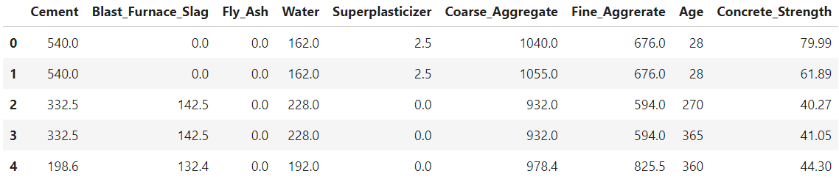
Dataset Particulars
Fine Aggregate
Finer particles within concrete, impacting both its workability and strength.
Age
The curing time since concrete was produced that affects its strength.

Slide 5
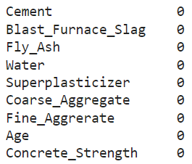
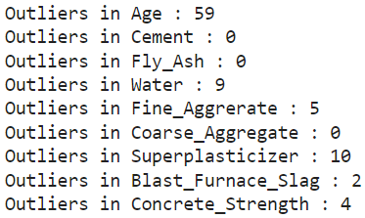
Data Preprocessing
1) Data Cleaning and Transformation:
Renamed columns for ease of use.
Created a dictionary for old-to-new column names.
2) Checking for Null Values:
Checked for null values in the dataset.
No null values found, no need for row removal.
3) Checking for Duplicate Values:
Identified 25 duplicate rows in the dataset.
These were not deleted as they were crucial for the analysis.
4) Checking for Outliers:
Evaluated outliers for specific columns.
Calculated Interquartile Range (IQR) for each column.
Null Values
Outliers

Slide 6
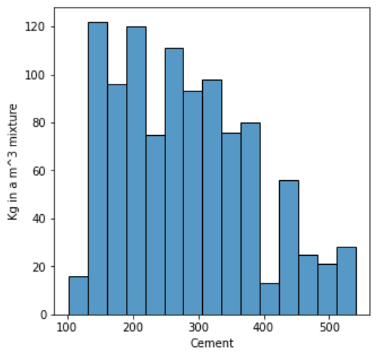
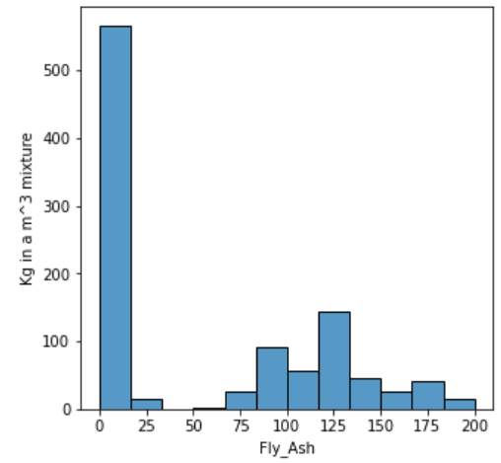
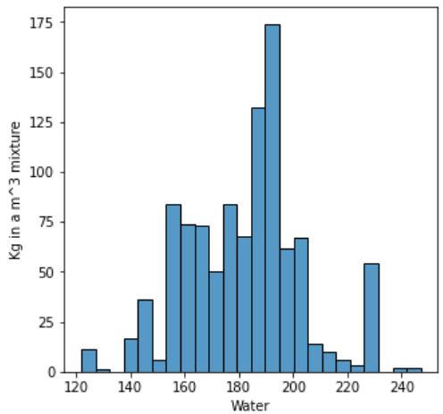
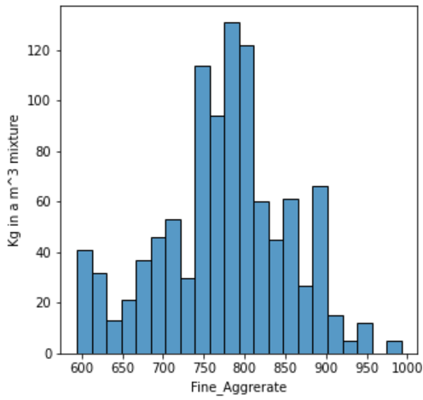
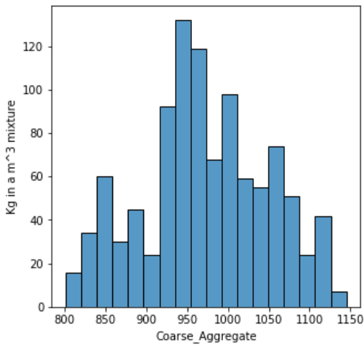
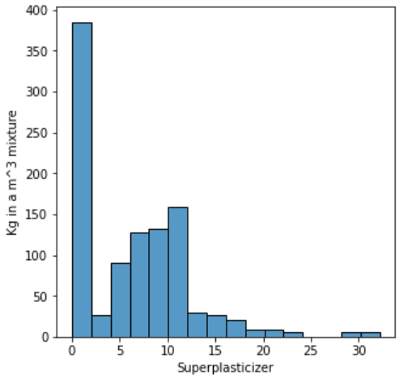
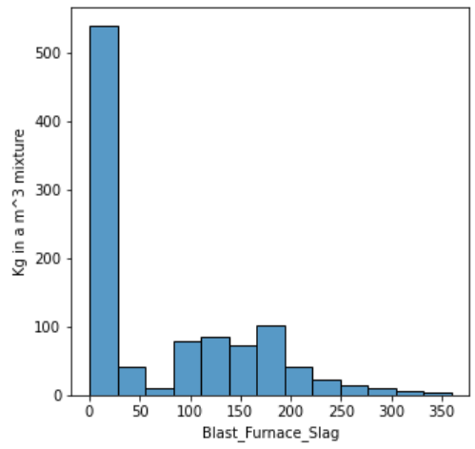
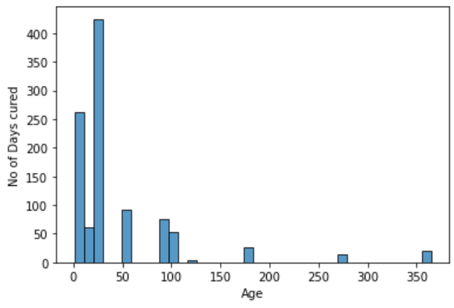
DATA ANALYSIS
Exploring the data's distribution and relationships helps us identify trends and potential outliers. Here, we've plotted histograms for key variables such as Cement, Water and Age.

Slide 7
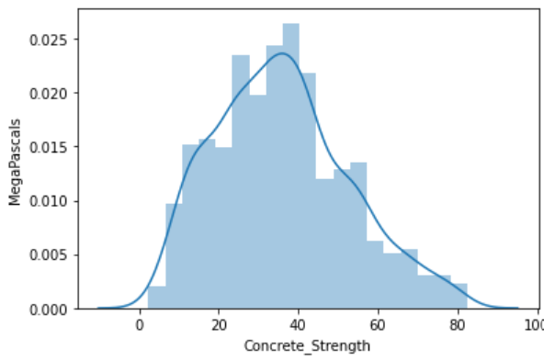
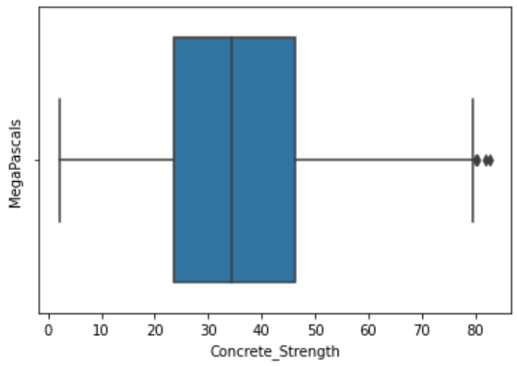
DATA ANALYSIS
Based on the depicted graph, both the mean and median strengths appear to hover around 35MPa. The data exhibits a slight rightward skew (positive skewness), with outliers noticeable at the higher end of the dataset.

Slide 8
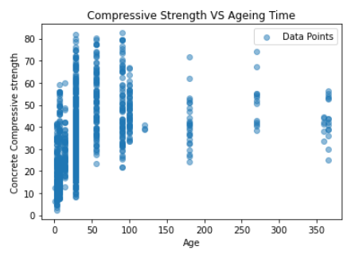
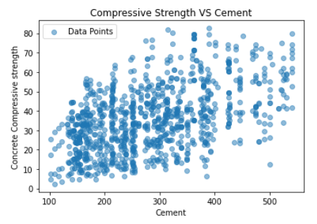
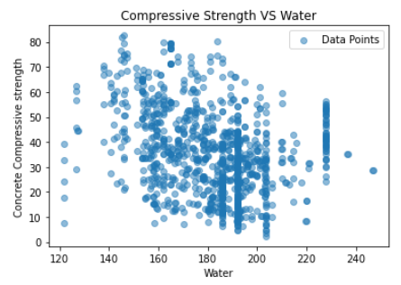
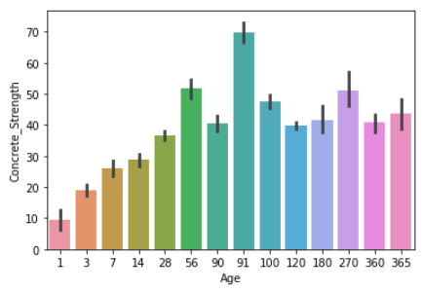
DATA ANALYSIS
The graph above demonstrates the influence of age on strength.
When the number of days is minimal, the concrete's strength is also diminished.
Conversely, for an extended period, the concrete strength tends to plateau at an average level.
The peak strength of concrete appears to fall within the range of 50 to 100 days, although certain intervening factors impact this trend.
The graph doesn't yield definitive conclusions about cement and water against concrete strength, yet discernible correlations are evident.

Slide 9
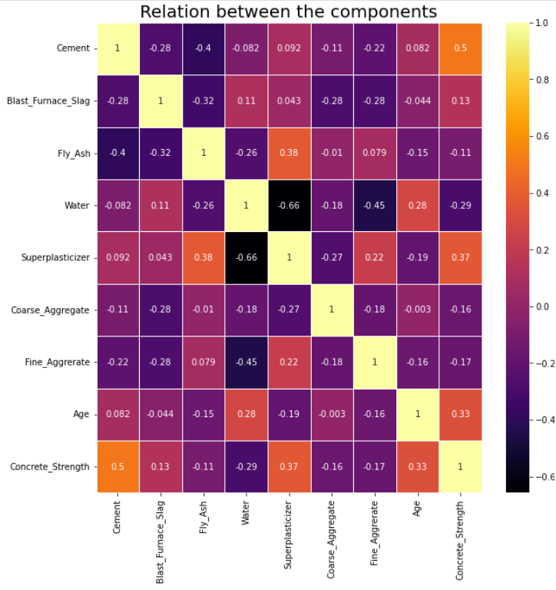
Correlation Analysis
The correlation coefficient spans from -1 to 1. Values closer to -1 or 1 signify robust negative or positive correlations, respectively. Value closer to 0 indicate no correlation
The map illustrates that cement significantly influences concrete strength.
Another influential factor is superplasticizer, with a coefficient of 0.37, impacting concrete strength.
Age also bears significance. The previous scatterplot suggests that optimal concrete strength is achieved with an age range of 20-100 days.
Water exhibits a negative correlation with concrete strength. An increase in water quantity results in a decrease in concrete strength quality.
Additionally, superplasticizer shows a strong negative correlation with water. Elevating superplasticizer reduces water quantity, promoting higher cement strength.

Slide 10
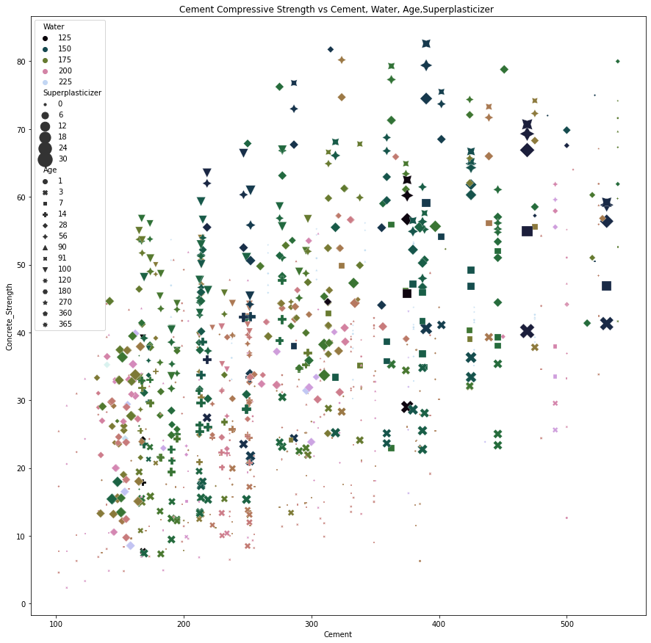
Cement Compressive Strength vs Cement, Water, Age & Superplasticizer
Cement: The amount of cement significantly influences concrete strength. Greater cement content usually results in higher compressive strength due to enhanced binding material.
Water: The water-cement ratio impacts concrete porosity. Excess water can reduce strength and durability by increasing porosity. A balanced ratio supports optimal strength.
Superplasticizer: Superplasticizers enhance workability without extra water, promoting denser and stronger concrete by reducing porosity.
Age: Concrete strength evolves with time as hydration reactions proceed. Initial concrete might have lower strength, but as curing time extends, strength advances.

Slide 11
CONCLUSION
As the cement content rises, there is a proportional enhancement in the strength of the concrete, underscoring the pivotal role of cement in influencing concrete strength.
The optimum strength of concrete is achieved when the curing duration spans from 90 to 200 days. This time frame fosters the ideal conditions for the concrete's strength development and durability.
The concrete's strength reaches a peak level when the superplasticizer component ranges from 10 to 25 kg in a m^3 mixture. Within this interval, the presence of superplasticizer contributes to denser and stronger concrete.
Maintaining an optimal water level, carefully aligned with the cement content, is essential. The right balance ensures that the concrete attains its desired strength, safeguarding against both excessive and insufficient water quantities.
Solution to the Problem
Enhancement of Quality Control:
Enhance the quality control protocol within the production plant. This involves thorough testing of key raw materials, particularly Cement, Water, and Superplasticizer.
Refinement of Production Process:
Refine the production process to optimize the utilization of essential materials like Cement, Water, and Superplasticizer, guided by correlation analysis. This refinement can contribute to increased uniformity in concrete strength.
Age-Dependent Supervision:
Utilize the correlation between Age and Concrete Compressive Strength to implement a monitoring system for tracking the progressive development of concrete strength over time. This practice ensures that the concrete achieves the desired strength levels before being delivered to clients.

